Slide 1

Analysis of Greek Airbnb Listings and Reviews
Using SQL

Slide 2

Outline
01.
Case Study and Purpose
02.
Dataset Breakdown
03.
Data Preparation
04.
Data Modelling
05.
Key Insights
06.
Conclusion

Slide 3

Case study and Purpose
1
This case study utilizes one dataset.
2
The analysis in this research is guided by these parameters.

Slide 4

Purpose
L
This presentation explores an Airbnb dataset of Greek listings, primarily concentrated in the heart of Athens. The dataset covers a variety of property types, with entries dating from 2008 to the present.
The main objective of the project is to derive valuable insights from the data, offering actionable recommendations for future Airbnb hosts.

Slide 5
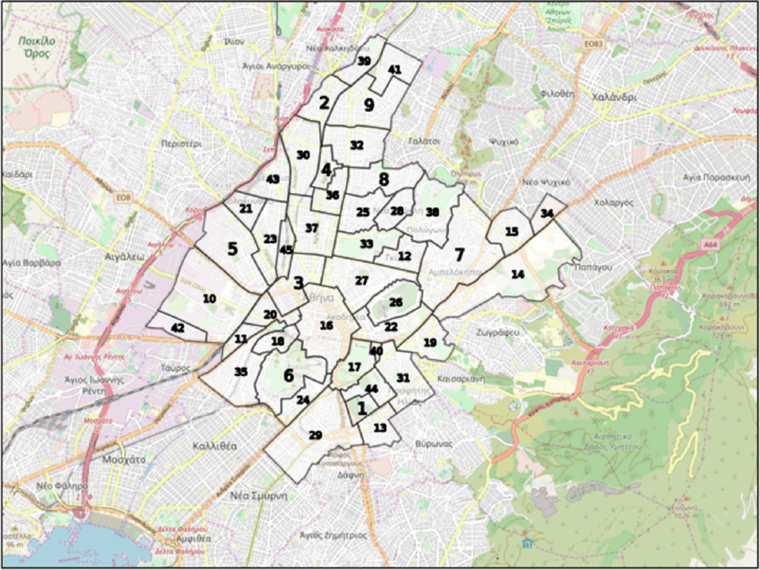
Dataset Breakdown
The Data Warehouse was built using SQL Server Management Studio.
The data columns refer to host features such as availability, pricing, and neighborhood location.
Contains various data types such as text,numeric and date.
Data sourced from Airbnb’s official website.

Slide 6


Data Preparation
We started with the first step of data processing, applying data cleaning methods to ensure the accuracy and consistency of the data.
Data Cleaning
Replaced specific values with numeric equivalents
Substituted null values with zeros where applicable
Used various SQL functions to modify data types. write other way

Slide 7
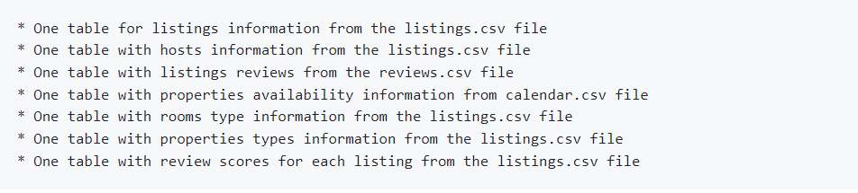
Data Modelling
To set up the schema for this analysis, we designed Fact and Dimension Tables to organize the data, resulting in a total of eight tables.
FactReviewScores
FactCalendar
FactReview
FactListings
DimRoomType
DimPropertyType
DimHost
DimReviewer

Slide 8
Acropolis properties for up to 8 guests attract larger groups.
The average Airbnb listing price across 7,335 neighborhoods in Greece is $121.45.
Larger Group Accommodation
Pricing Trends
Key Insights
98% of Superhosts have profilepic compared to 94% of Non-Superhosts.
The Acropolis neighborhood has the highest average listing price at $415.
High Priced Neighborhoods
Superhost Profile Behavior

Slide 9
Non-superhosts own more properties, but both prefer listing entire two-bed apartments.
Acropolis ranks 12th in property scores, despite its higher average prices.
Host Ownership & Property Type
Top Neighborhoods by Average Property Score
Key Insights
Hotels average 1,037 nights, while entire apartments average 912 nights for max bookings.
The number of bookings spikes in September and October.
Stay Duration Insights
Seasonal Trends

Slide 10
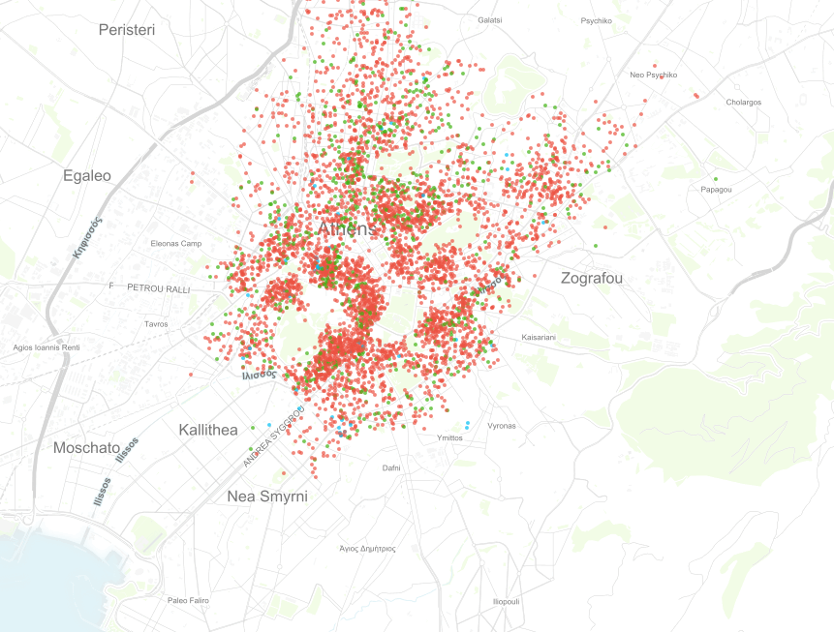

Conclusion
This project revealed key insights into Airbnb listings in Greece, such as high prices in Acropolis, the demand for larger accommodations, and the slight advantage of profile pictures for Superhosts.
Seasonal booking trends and preferences for longer stays were also identified, offering useful recommendations for hosts and investors.
References and Further Information
GitHub Repository:
Explore the code and analysis
GitHub Portfolio Page

